Slide 1
__ __ ____ ____ ____ ____ _ _ ____ ( ) / _\ ( _ \ / ___)( __)(_ _)/ )( \( _ \ / (_/\/ \ ) _ ( \___ \ ) _) )( ) \/ ( ) __/ \____/\_/\_/(____/ (____/(____) (__) \____/(__)
Mac OS X

Slide 2
Tools
Burp Suite
browser intercept proxy
Tamper Data
Firefox add-on
intercept proxy
Hackbar
Firefox add-on
request repeater and misc.
Cookie Manager+
Firefox add-on
cookie editor
Wireshark
packet capture

Slide 3
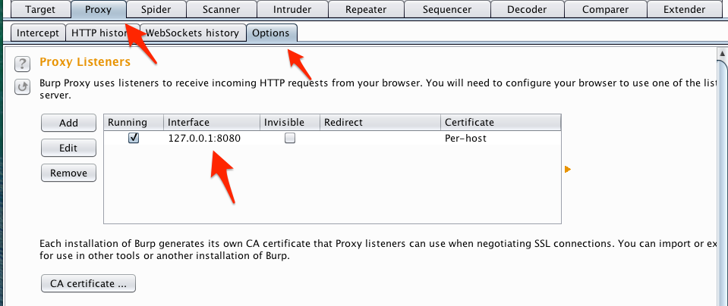
Setting up Burp
Download Burp
http://portswigger.net/burp/downloadfree.html
Required Java
Run Burp
Default port is 8080
Default port can be changed in Proxy > Options > Proxy Listeners

Slide 4
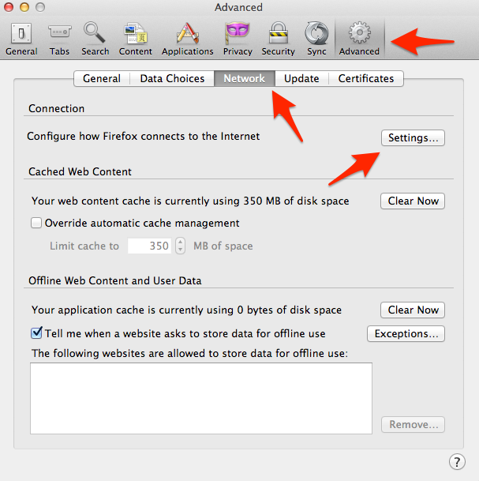
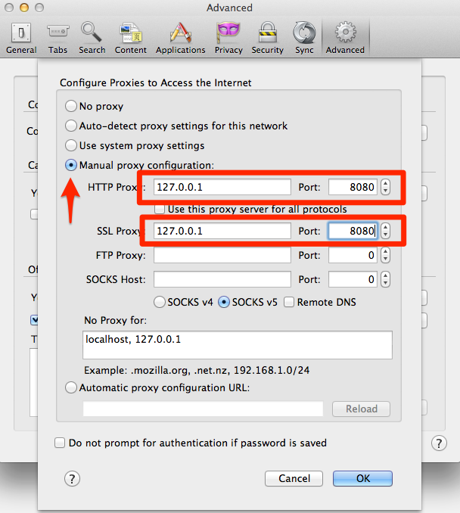
Configuring Firefox with Burp
Configure Firefox to use Burp as a proxy for HTTP and SSL
Firefox > Preferences > Advanced > Network > Settings
Select Manual proxy configuration
Fill in the HTTP proxy and SSL proxy with 127.0.0.1 port 8080

Slide 5
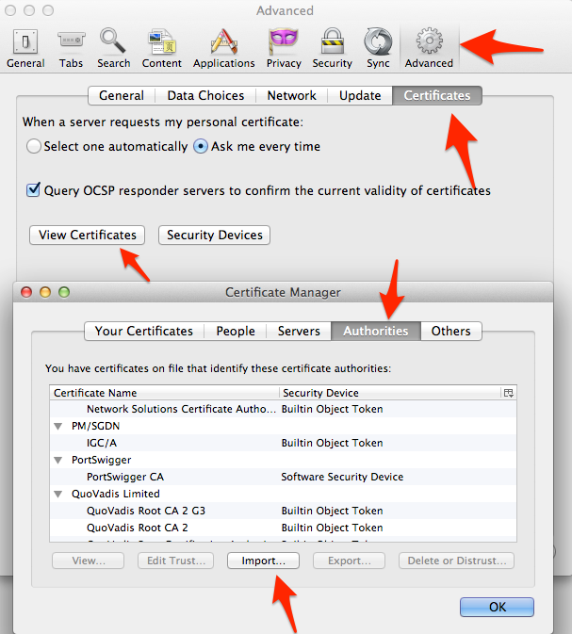
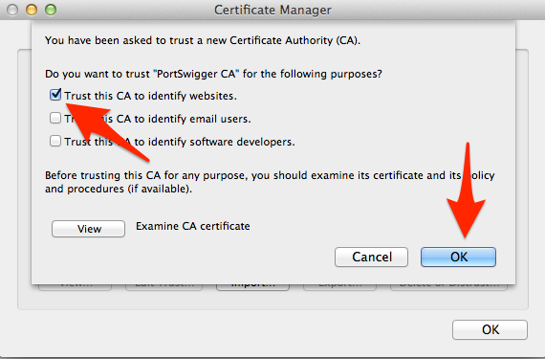
Intercepting SSL with Firefox
Navigate to http://burp
Click “CA Certificate” and download cacert.der
File > Preferences > Advanced > Certificates >View Certificates > Authorities > Import
Check “Trust this CA to identify websites.”
Click OK

Slide 6
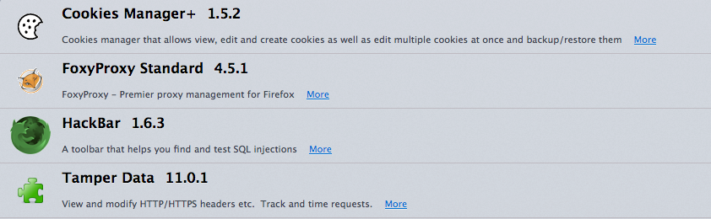
Setting up Tamper Data, Cookie Manager+, and HackBar
Tools > Add-ons
Search for and install Tamper Data, HackBar, and Cookie Manager+

Slide 7
Setting up Wireshark
Download the installer – OS X and later Intel 64-bit.dmg
https://www.wireshark.org/download.html
Double click the .dmg file and double click the package to install

